Slide 1


Agentic AI

Slide 2
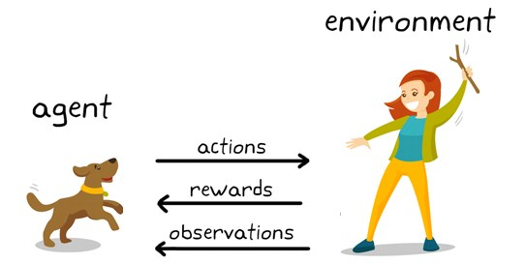
AI Agent

Slide 3
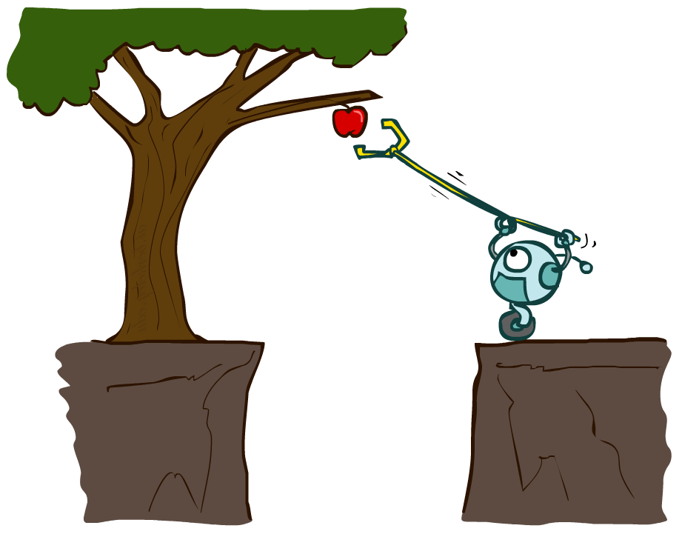
Agents and environments

Slide 4
Agents and environments
Agent
Environment
Sensors
Percepts
?
Actuators
Actions
An agent perceives its environment through sensors and acts upon it through actuators (or effectors, depending on whom you ask)

Slide 5
Agents and environments
Agent
Environment
Sensors
Percepts
?
Actuators
Actions
Are humans agents?
Yes!
  Sensors = vision, audio, touch, smell, taste, proprioception
  Actuators = muscles, secretions, changing brain state

Slide 6
Agents and environments
Agent
Environment
Sensors
Percepts
?
Actuators
Actions
Are pocket calculators agents?
Yes!
  Sensors = key state sensors
  Actuators = digit display

Slide 7
Example: Vacuum world
Percepts: [location,status], e.g., [A,Dirty]
Actions: Left, Right, Suck, NoOp

Slide 8
Vacuum cleaner agent
Agent function
Agent program
Percept sequence | Action
[A,Clean] | Right
[A,Dirty] | Suck
[B,Clean] | Left
[B,Dirty] | Suck
[A,Clean],[B,Clean] | Left
[A,Clean],[B,Dirty] | Suck
etc | etc
function Reflex-Vacuum-Agent([location,status])
returns an action
if status = Dirty then return Suck
else if location = A then return Right
else if location = B then return Left
What is the right agent function?
Can it be implemented by a small agent program?
(Can we ask, “What is the right agent program?”)

Slide 9
Rationality
Fixed performance measure evaluates the environment sequence
  one point per square cleaned up?
    NO! Rewards an agent who dumps dirt and cleans it up
  one point per clean square per time step, for t = 1,…,T
A rational agent chooses whichever action maximizes the expected value of the performance measure
  given the percept sequence to date and prior knowledge of environment
Does Reflex-Vacuum-Agent implement a rational agent function?
Yes, if movement is free, or new dirt arrives frequently
Notes:
The dirt-dumping problem is an example of the King Midas problem – mis-specifying the objective

Slide 10
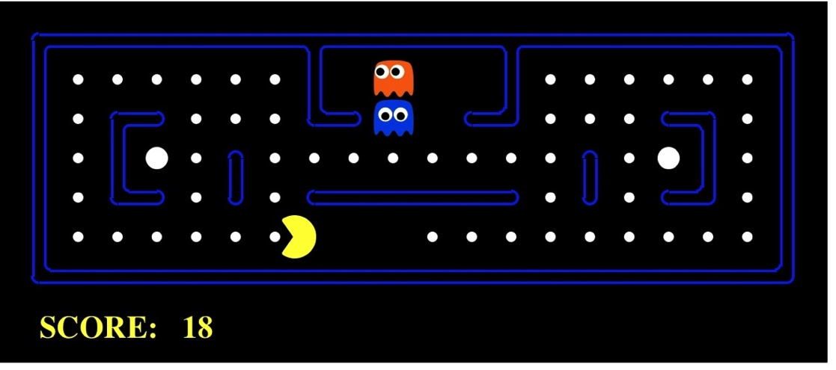
Pac-Man as an Agent
Agent
Environment
Sensors
Percepts
?
Actuators
Actions
Pac-Man is a registered trademark of Namco-Bandai Games, used here for educational purposes

Slide 11

The task environment - PEAS
Performance measure
  -1 per step; + 10 food; +500 win; -500 die; +200 hit scared ghost
Environment
  Pacman dynamics
Actuators
  Left Right Up Down
Sensors
  Entire state is visible

Slide 12
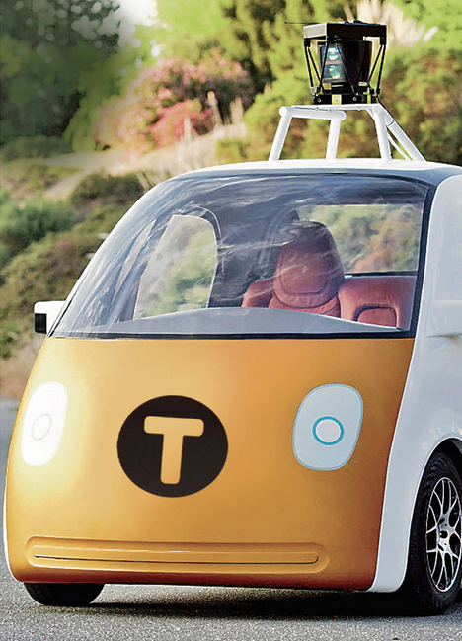
PEAS: Automated taxi
Performance measure
  Income, happy customer, vehicle costs, fines, insurance premiums
Environment
  streets, other drivers, customers, weather, police…
Actuators
  Steering, brake, gas, display/speaker
Sensors
  Camera, radar, accelerometer, engine sensors, microphone, GPS
Image: http://nypost.com/2014/06/21/how-google-might-put-taxi-drivers-out-of-business/

Slide 13


PEAS: Medical diagnosis system
Performance measure
  Patient health, cost, reputation
Environment
  Patients, medical staff, insurers, courts
Actuators
  Screen display, email
Sensors
  Keyboard/mouse

Slide 14
More Examples
Agent | Performance Measure | Environment | Actuator | Sensor
Hospital Management System | Patient’s health, Admission process, Payment | Hospital, Doctors, Patients | Prescription, Diagnosis, Scan report | Symptoms, Patient’s response
Automated Car Drive | Comfortable trip, Safety, Maximum Distance | Roads, Traffic, Vehicles | Steering wheel, Accelerator, Brake, Mirror | Camera, GPS, Odometer
Subject Tutoring | Maximize scores, Improvement is students | Classroom, Desk, Chair, Board, Staff, Students | Smart displays, Corrections | Eyes, Ears, Notebooks
Part -picking Robot | Percentage of parts in correct bins | Conveyor belt with parts, Bins | Jointed Arms, Hand | Camera, Joint angle, sensors

Slide 15
The different types of agents
Agent Type | Description | Example
Simple Reflex Agents | Perform immediate actions based on predefined rules. | Travel agent interprets the context of the email and forwards travel complaints to customer service.
Model-Based Reflex Agents | Perform actions based on a model of the world and changes to that model. | Travel agent prioritizes routes with significant price changes based on access to historical pricing data.
Goal-Based Agents | Create plans to achieve specific goals by interpreting the goal and determining actions to reach it. | Travel agent books a journey by determining necessary travel arrangements (car, public transit, flights) from the current location to the destination.
Utility-Based Agents | Consider preferences and weigh tradeoffs numerically to determine how to achieve goals. | Travel agent maximizes utility by weighing convenience vs. cost when booking travel.
Learning Agents | Improve over time by responding to feedback and adjusting actions accordingly. | Travel agent improves by using customer feedback from post-trip surveys to make adjustments to future bookings.
Hierarchical Agents | Feature multiple agents in a tiered system, with higher-level agents breaking tasks into subtasks for lower-level agents to complete. | Travel agent cancels a trip by dividing the task into subtasks (for example, canceling specific bookings) and having lower-level agents complete them, reporting back to the higher-level agent.
Multi-Agent Systems (MAS) | Agents complete tasks independently, either cooperatively or competitively. | Cooperative: Multiple agents book specific travel services such as hotels, flights, and entertainment. Competitive: Multiple agents manage and compete over a shared hotel booking calendar to book customers into the hotel.

Slide 16
Definitions
LLM (Large Language Model): A foundational AI model trained on vast amounts of text to predict and generate human-like language. It responds to prompts but does not have goals or plans on its own. Example: GPT, Claude, LLaMA.
Agentic AI: An AI system that exhibits agent-like behavior, including the ability to plan, make decisions, take actions, and use tools to accomplish goals autonomously or semi-autonomously.

Slide 17
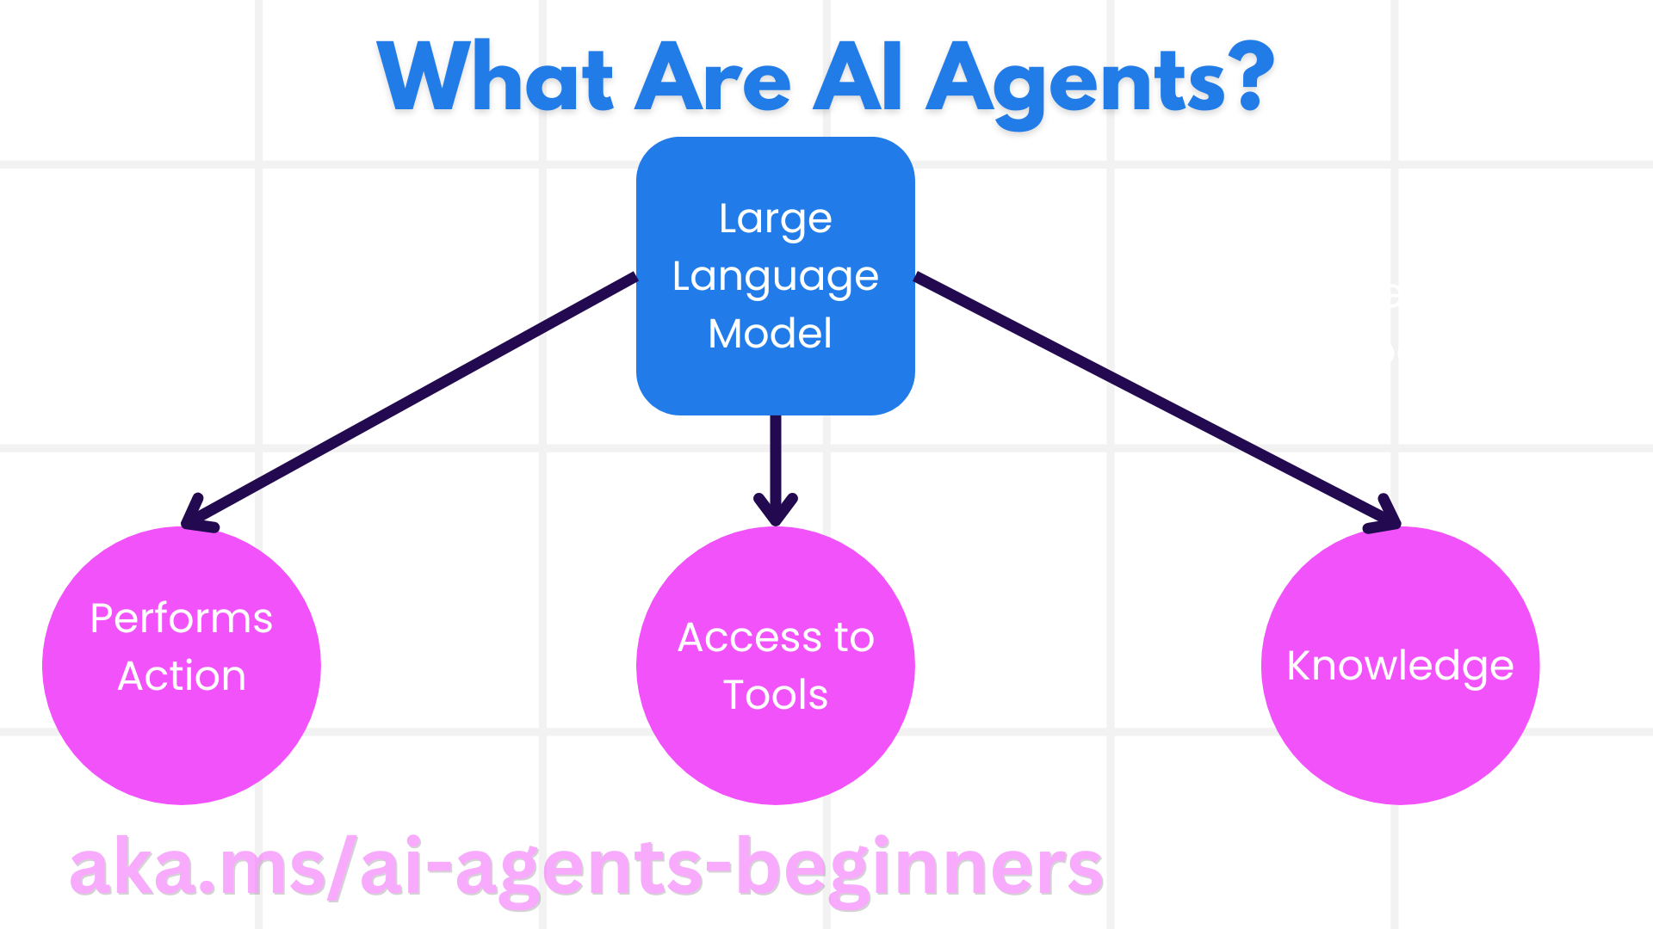

Slide 18
Tool Use Design Pattern
Tools allow AI agents to have a broader range of capabilities.
By adding a tool, the agent can now perform a wide range of actions instead of limit set of actions.

Slide 19
What is the Tool Use Design Pattern?
The Tool Use Design Pattern focuses on giving LLMs the ability to interact with external tools to achieve specific goals.
Tools are code that can be executed by an agent to perform actions.
A tool can be a simple function such as a calculator, or an API call to a third-party service such as stock price lookup or weather forecast.

Slide 20
What are the use cases it can be applied to?
Dynamic Information Retrieval: Agents can query external APIs or databases to fetch up-to-date data (e.g., querying a SQLite database for data analysis, fetching stock prices or weather information).
Code Execution and Interpretation: Agents can execute code or scripts to solve mathematical problems, generate reports, or perform simulations.
Workflow Automation: Automating repetitive or multi-step workflows by integrating tools like task schedulers, email services, or data pipelines.
Customer Support: Agents can interact with CRM systems, ticketing platforms, or knowledge bases to resolve user queries.
Content Generation and Editing: Agents can leverage tools like grammar checkers, text summarizers, or content safety evaluators to assist with content creation tasks.

Slide 21
Building blocks to implement the tool use design pattern
Function/Tool Schemas: Detailed definitions of available tools, including function name, purpose, required parameters, and expected outputs. These schemas enable the LLM to understand what tools are available and how to construct valid requests.
Function Execution Logic: Governs how and when tools are invoked based on the user’s intent and conversation context. This may include planner modules, routing mechanisms, or conditional flows that determine tool usage dynamically.
Message Handling System: Components that manage the conversational flow between user inputs, LLM responses, tool calls, and tool outputs.
Tool Integration Framework: Infrastructure that connects the agent to various tools, whether they are simple functions or complex external services.
Error Handling & Validation: Mechanisms to handle failures in tool execution, validate parameters, and manage unexpected responses.
State Management: Tracks conversation context, previous tool interactions, and persistent data to ensure consistency across multi-turn interactions.

Slide 22
LLMs vs Agentic AI
Feature | LLMs (Large Language Models) | Agentic AI
Definition | AI models trained to generate or understand text based on patterns in data | AI systems that can plan, make decisions, and act autonomously to achieve goals
Main Function | Generate text, answer questions, summarize, translate | Perform tasks, make sequential decisions, interact with environments autonomously
Autonomy | Passive; responds to prompts | Active; can take initiative and execute actions
Memory / Context | Usually limited to the conversation or prompt | Often maintains state, long-term memory, or planning context
Decision Making | Based on probability of next word | Based on goals, planning, and feedback from environment
Use Cases | Text generation, coding help, Q&A, summarization | Task automation, research assistants, autonomous agents, multi-step workflows
Planning | No inherent planning | Uses planning and decision-making loops
Tool Use | Only if explicitly integrated | Can autonomously select and use tools (e.g., search, code, APIs)

Slide 23
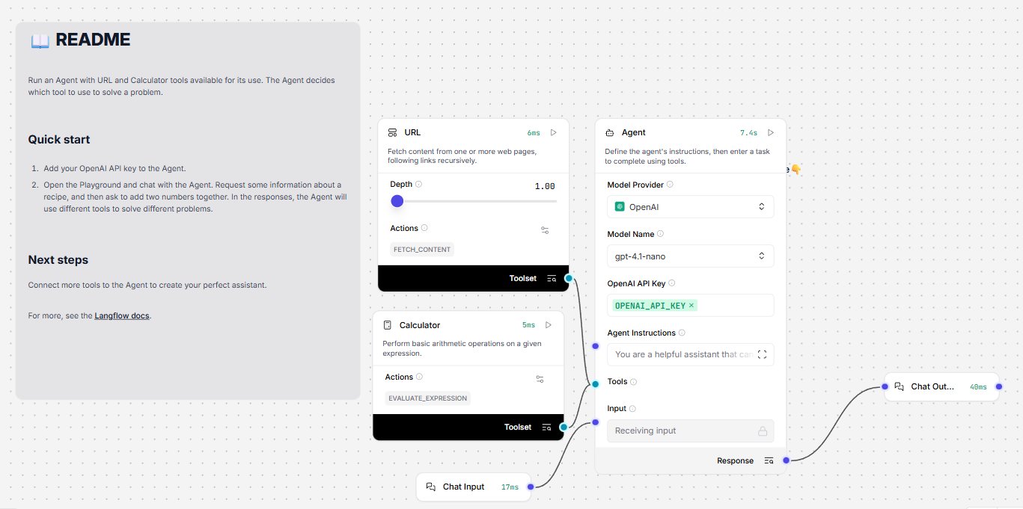
Simple Agent with calc and URL

Slide 24
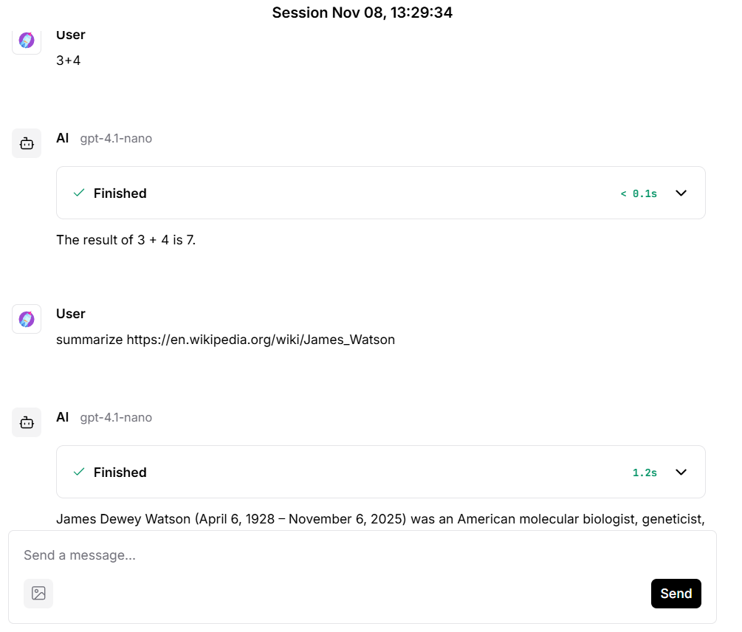

Slide 25


Q&A

